Slide 1

Web Browser
Senior Project Defense – By Derrick Kamphaus

Slide 2
Over View
Game Features
Demo
Challenges
Details

Slide 3
Features
Purpose
Educational experience to enrich children’s learning
Fully playable video game with 3 levels
Educational game that asks questions
Questions can be changed and updated with text files
Allows Educational providers to provide meaningful content
All original artwork
All coded from scratch with C#
Built with Unity 2D

Slide 4
Game Demo
Menus
Settings
Overworld
Level 1
Level 2 – 3 overview

Slide 5
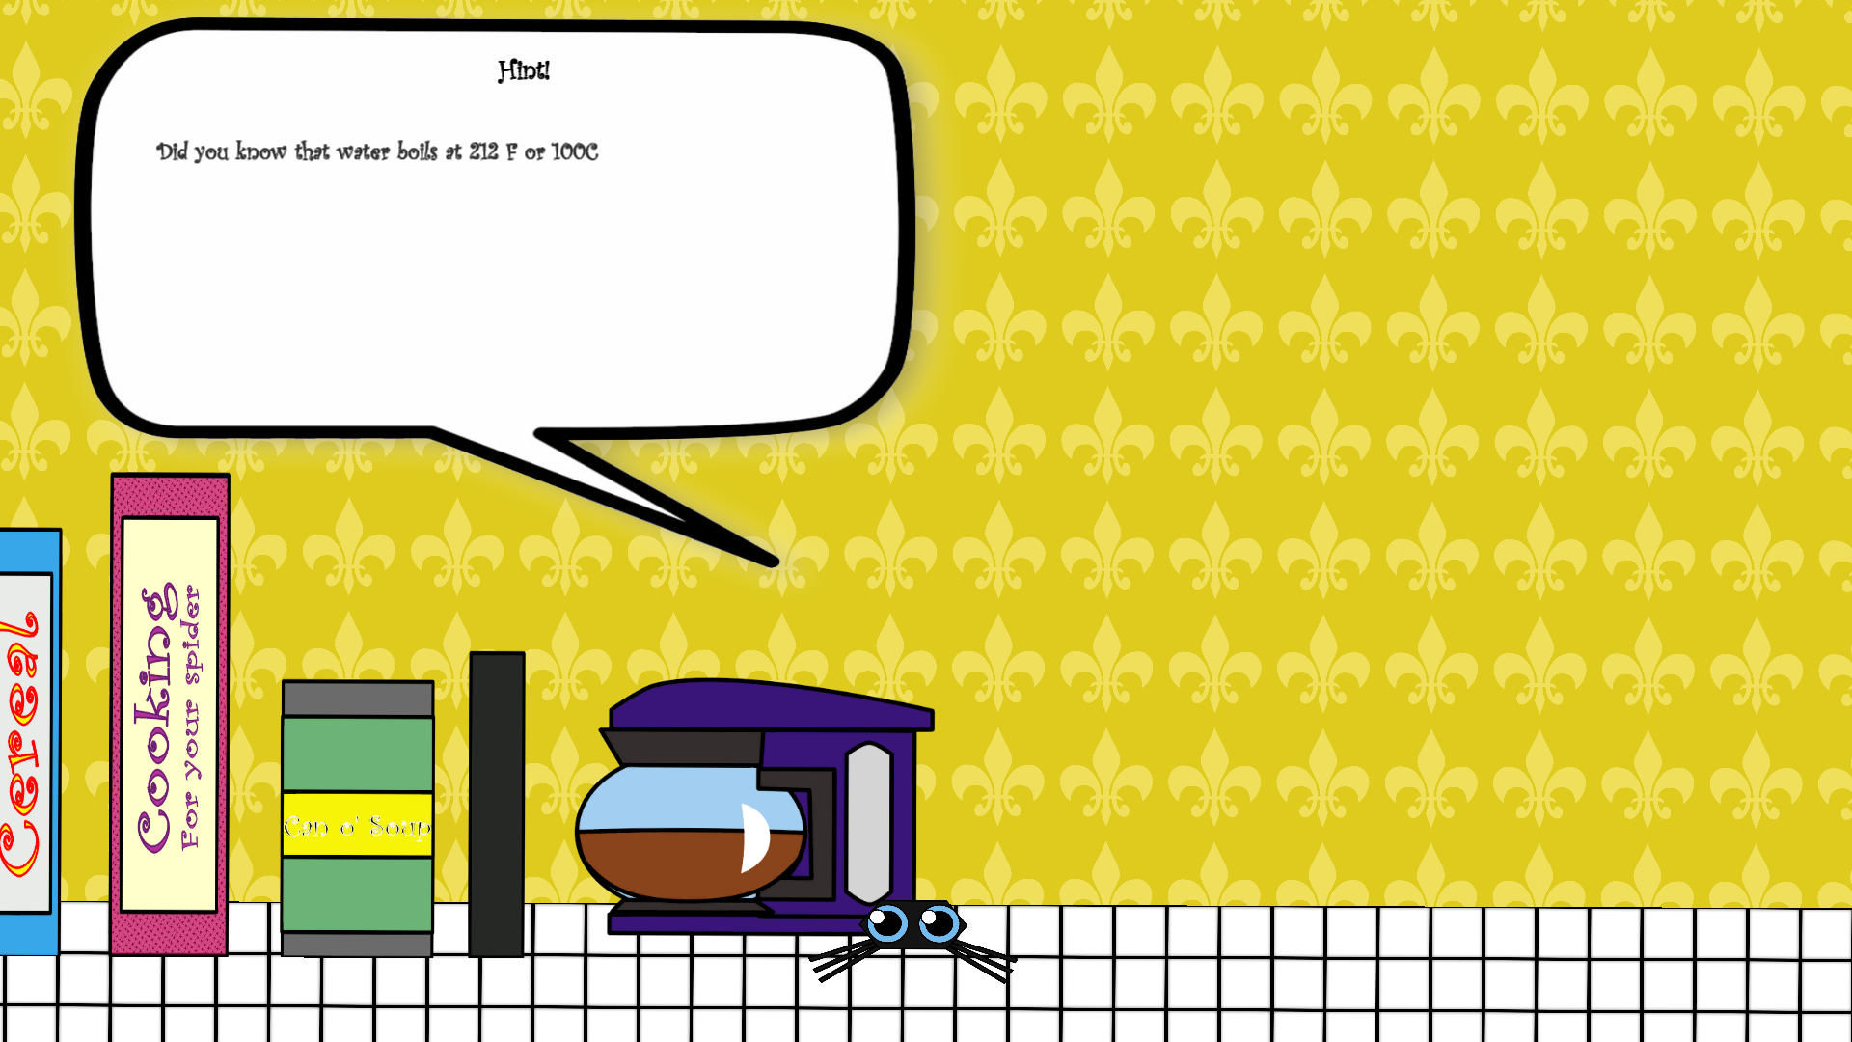
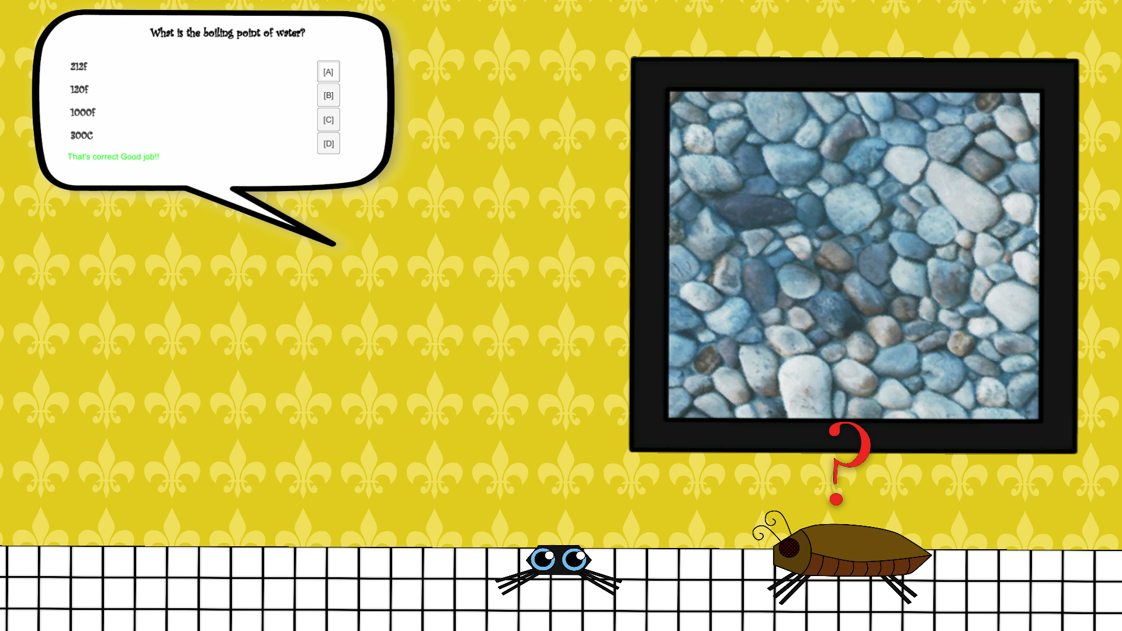
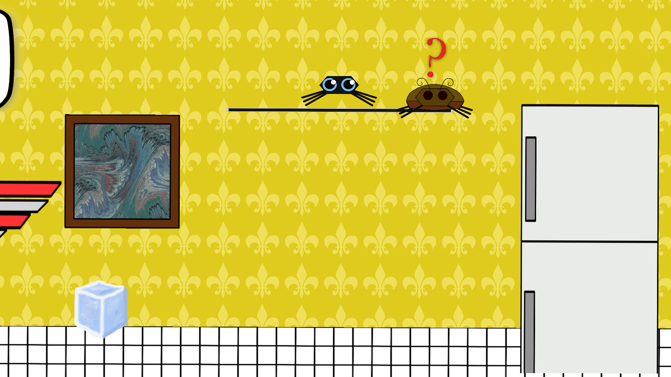
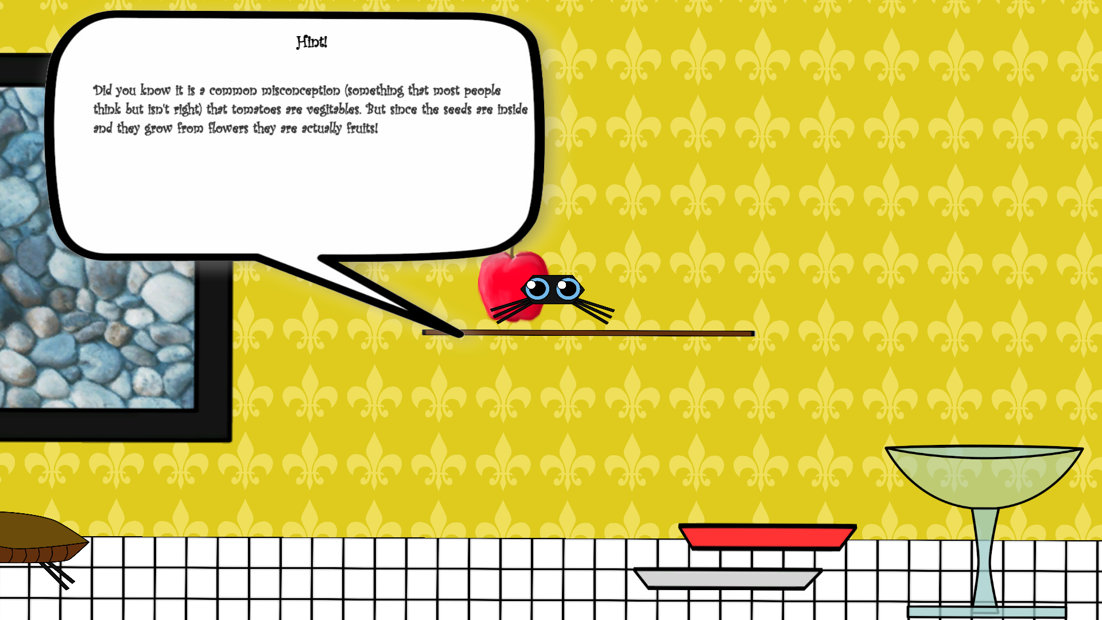
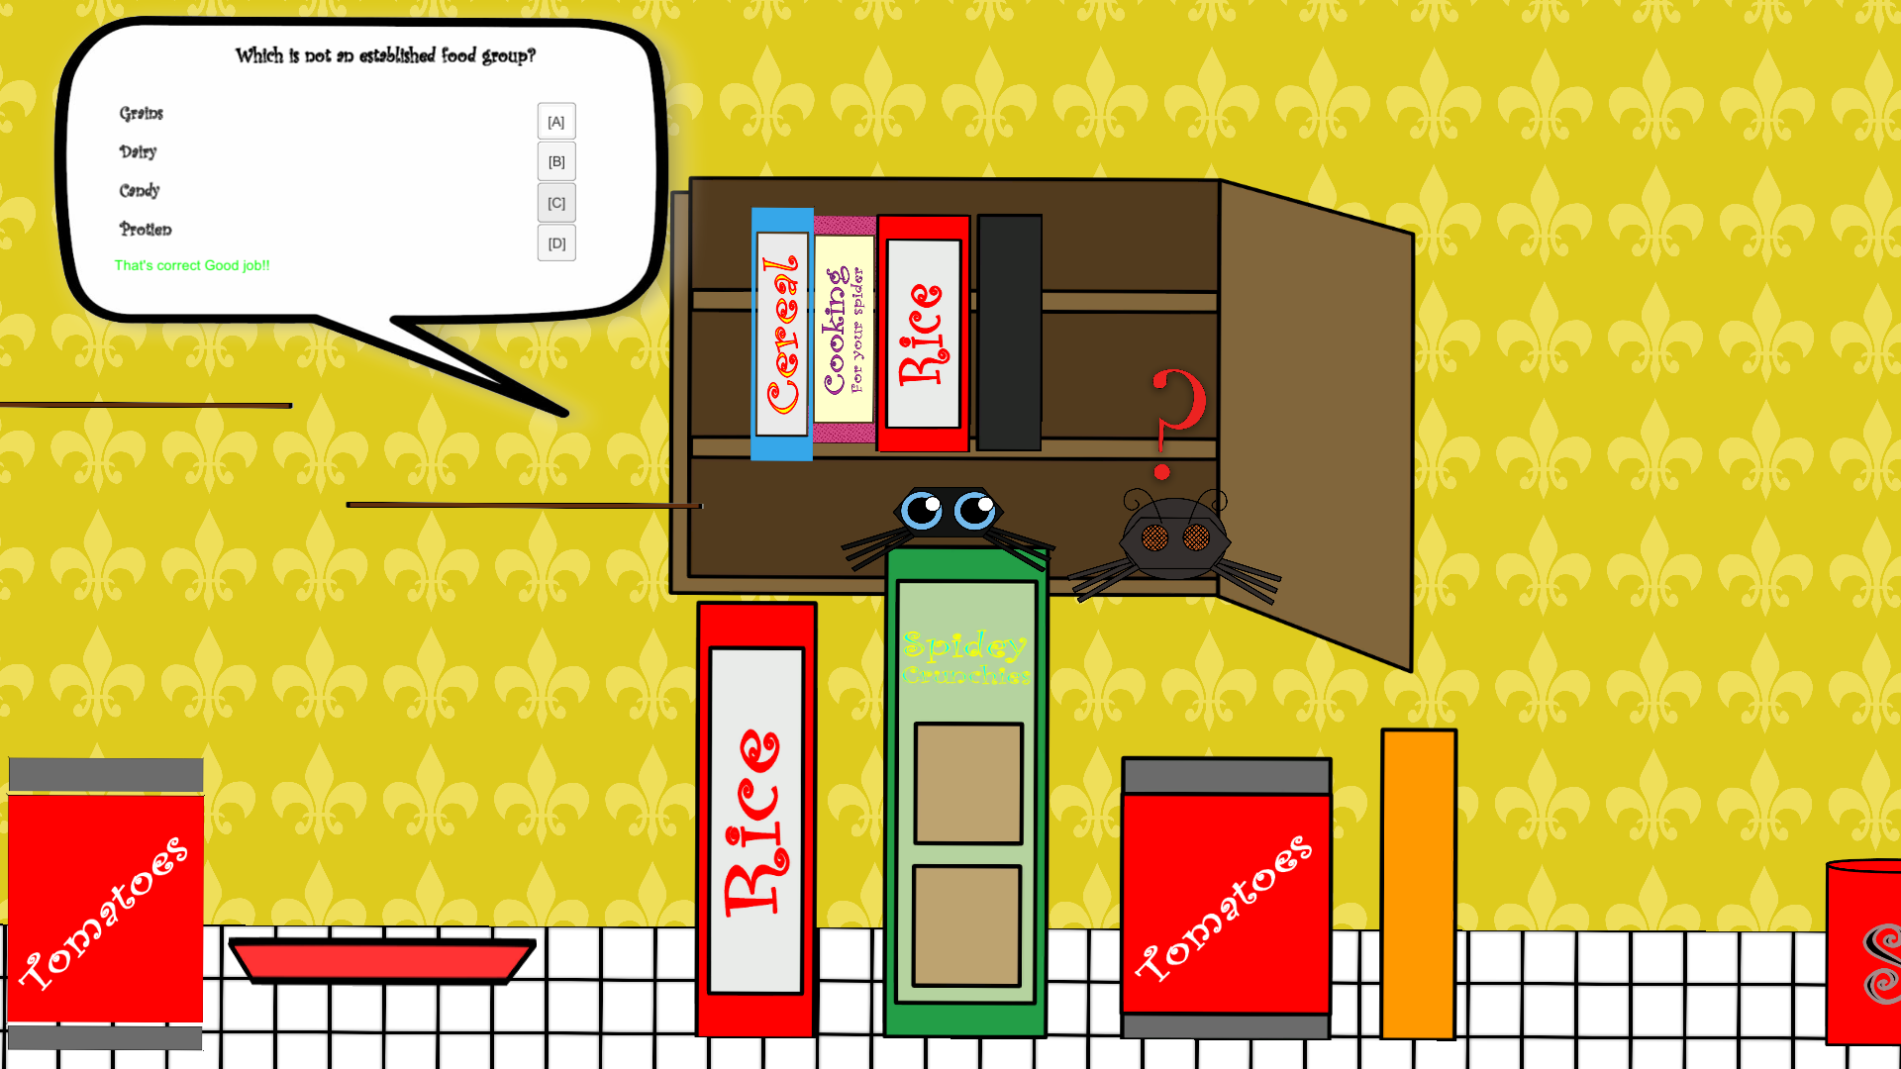
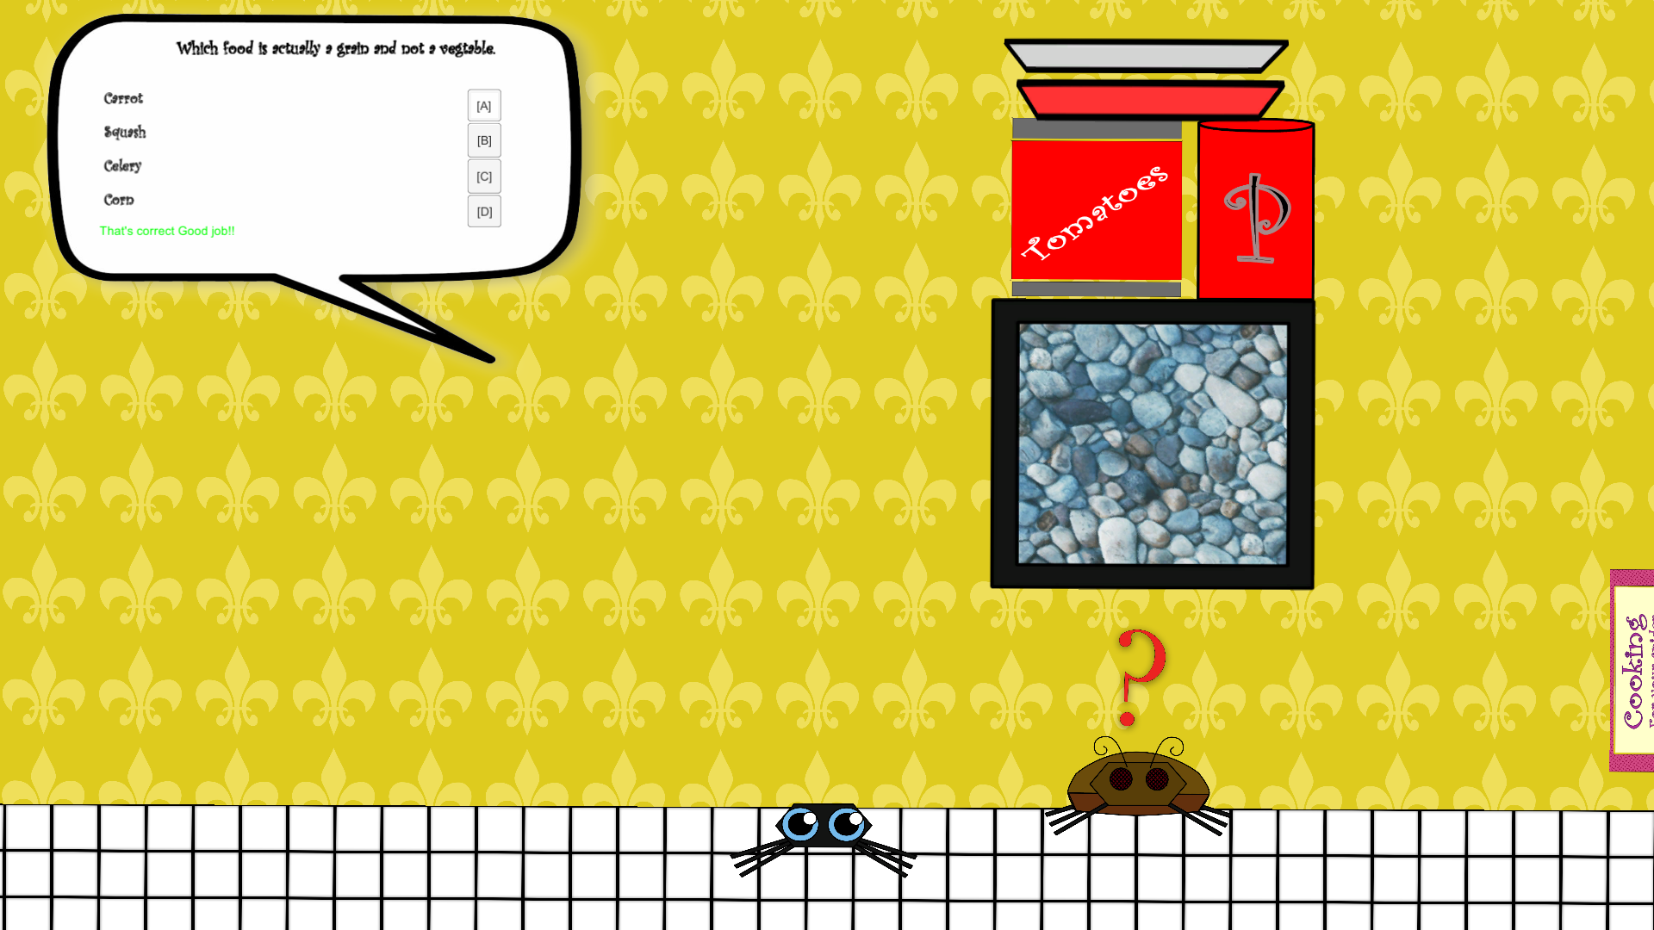

Slide 6
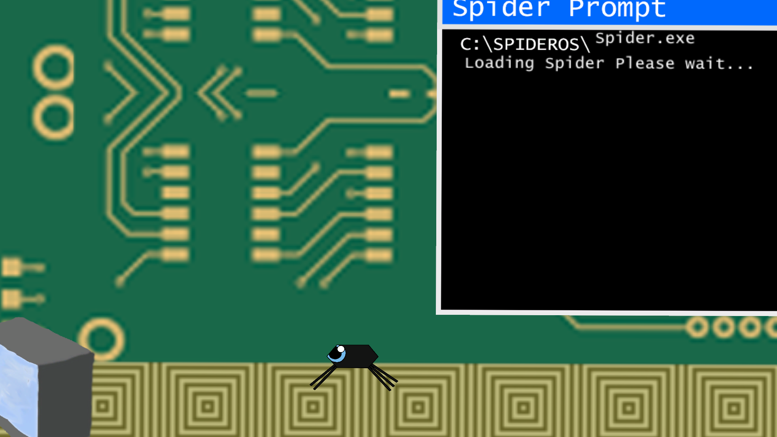
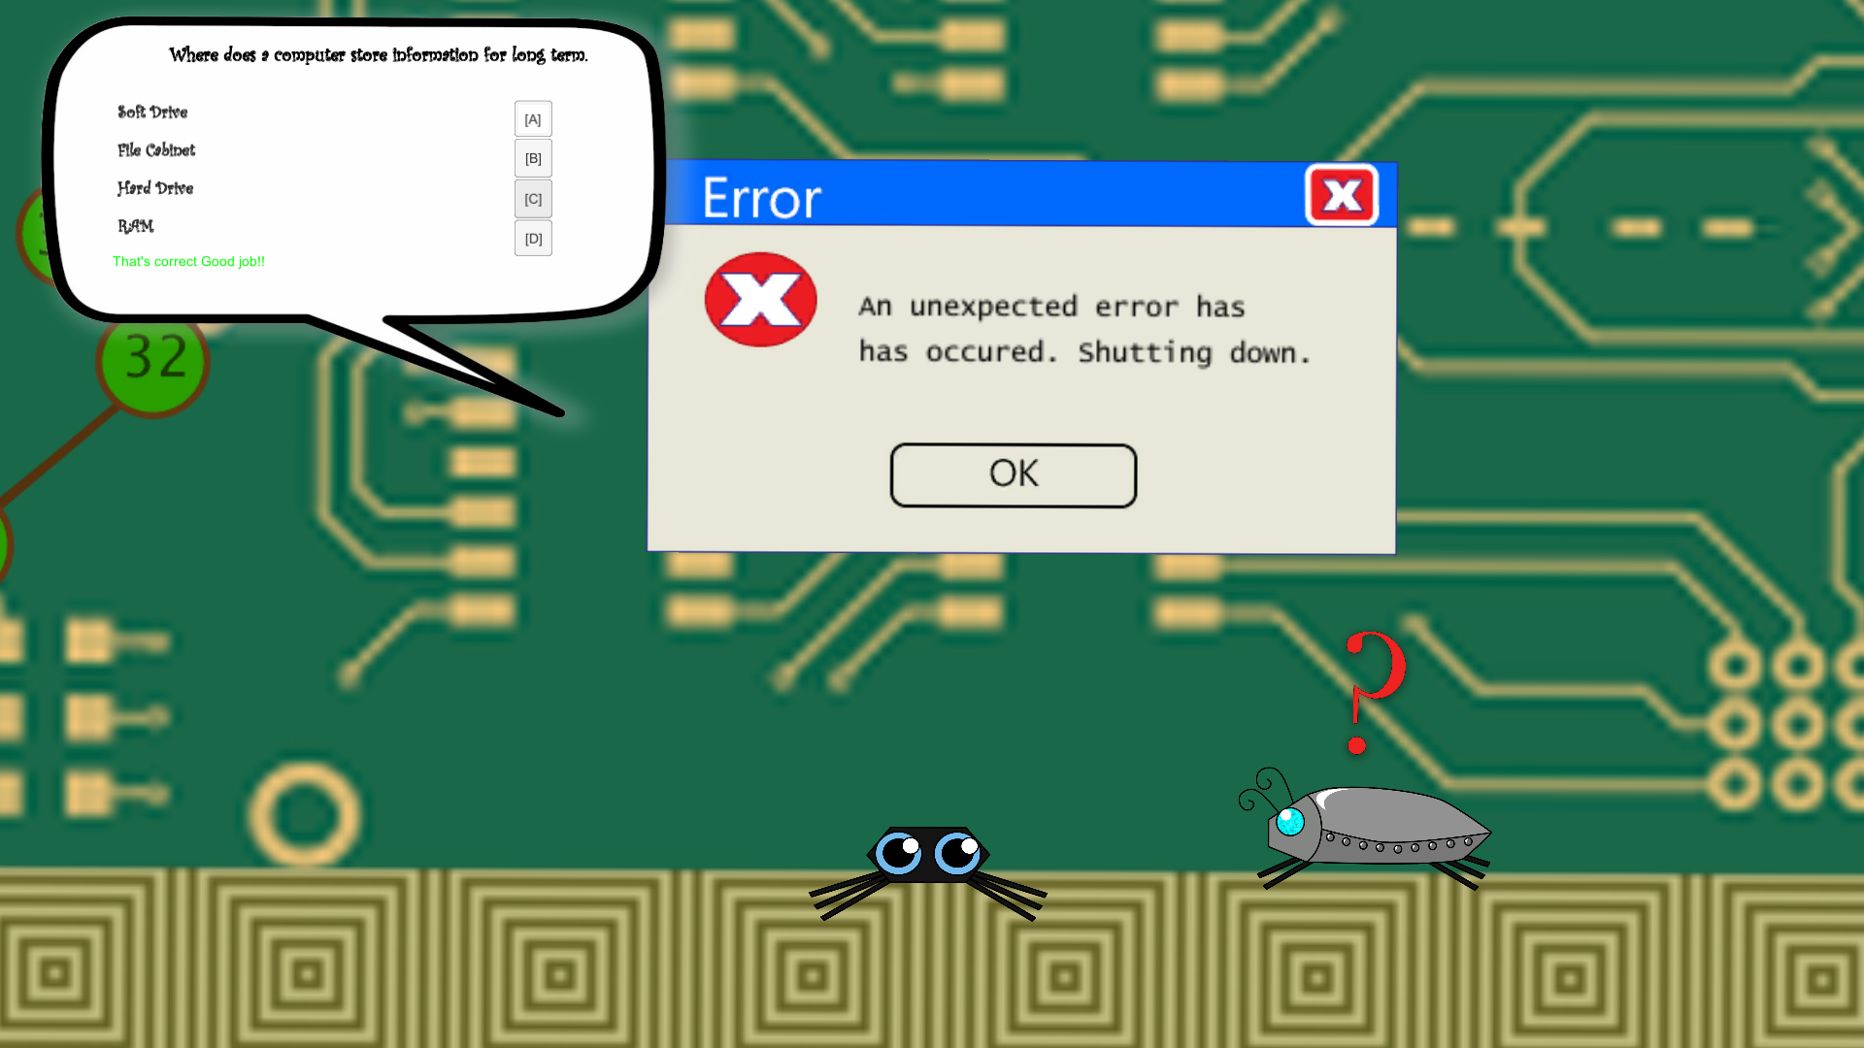
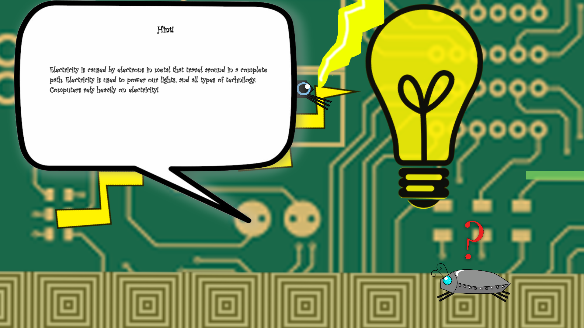
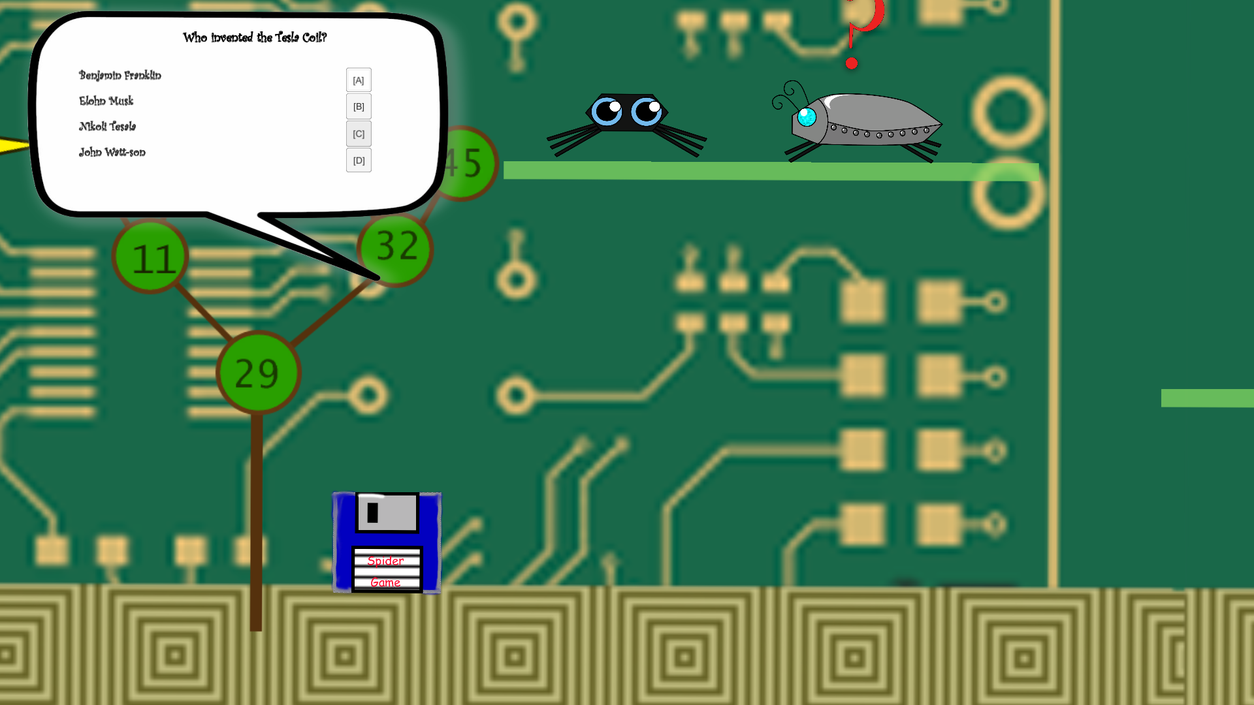
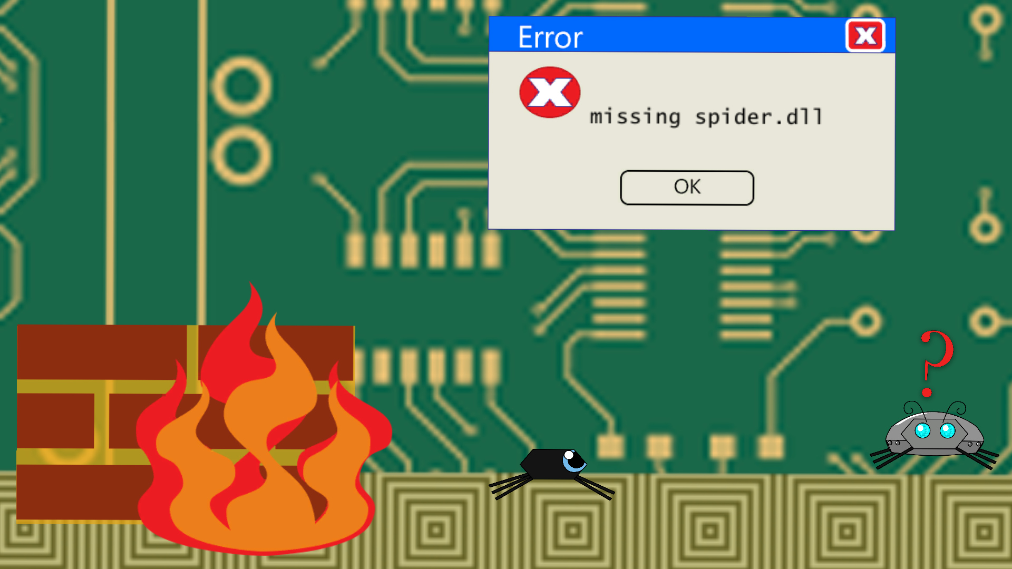
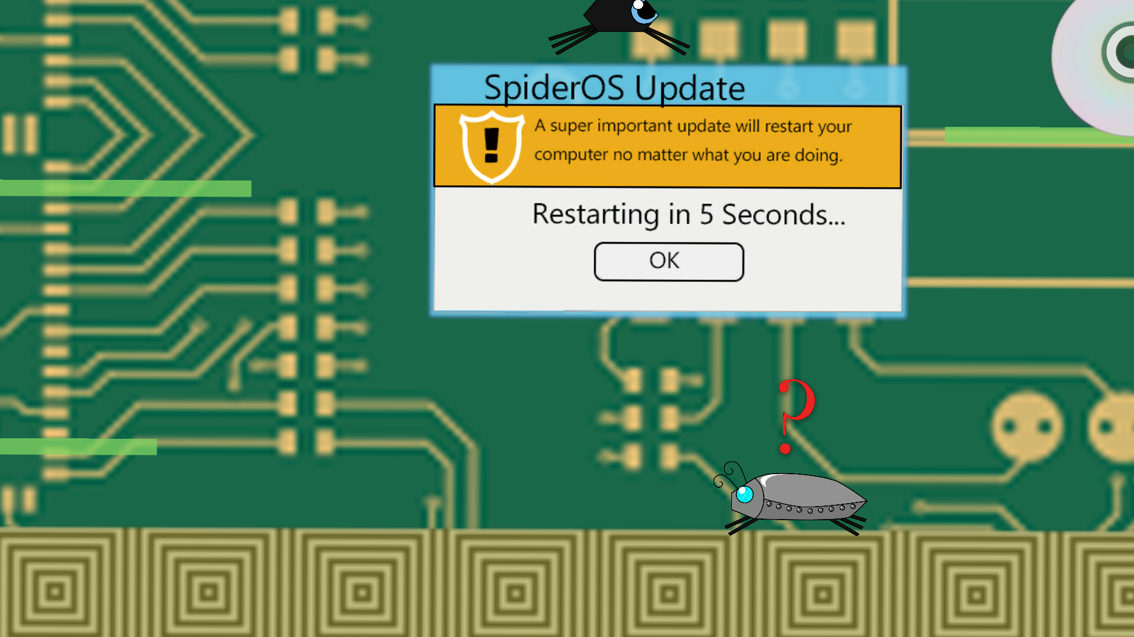

Slide 7


Details
Unity IDE
Visual Studio – C#
Visual Assets
Integrating All Parts Together

Slide 8
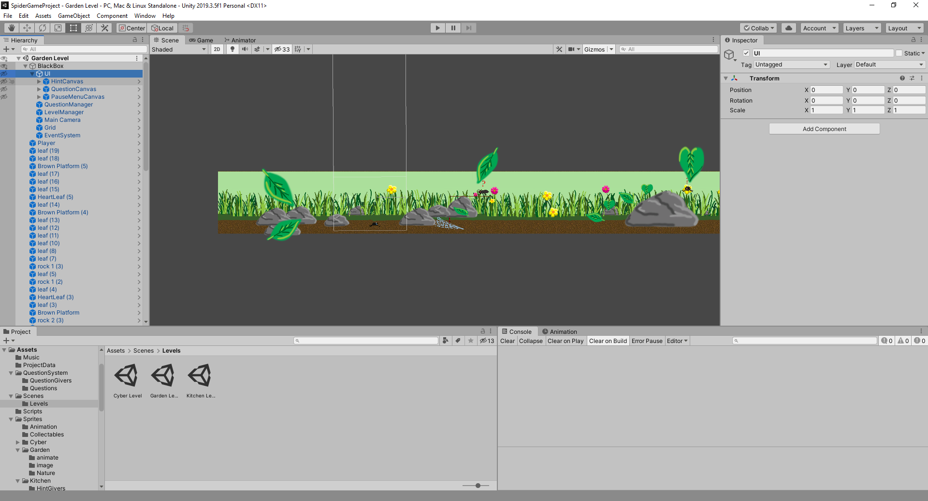
Unity
Unity is a free Game IDE
Project consists of Assets, and Scenes
Each Scene is a level / menu
Every object in scene visible or not is on the left

Slide 9
Scripting in C#
Unity provides the place to put all the assets and objects and instances together
While there are some premade systems ready for use, most of unity relies on scripting to actually get functionality
Web Browser uses all custom scripts I created
Unity uses C# and has built in tools to integrate to Visual Studio – the IDE I used for coding
Code utilized Unity Libraries and had no OS specific calls making it flexible for other platforms.

Slide 10
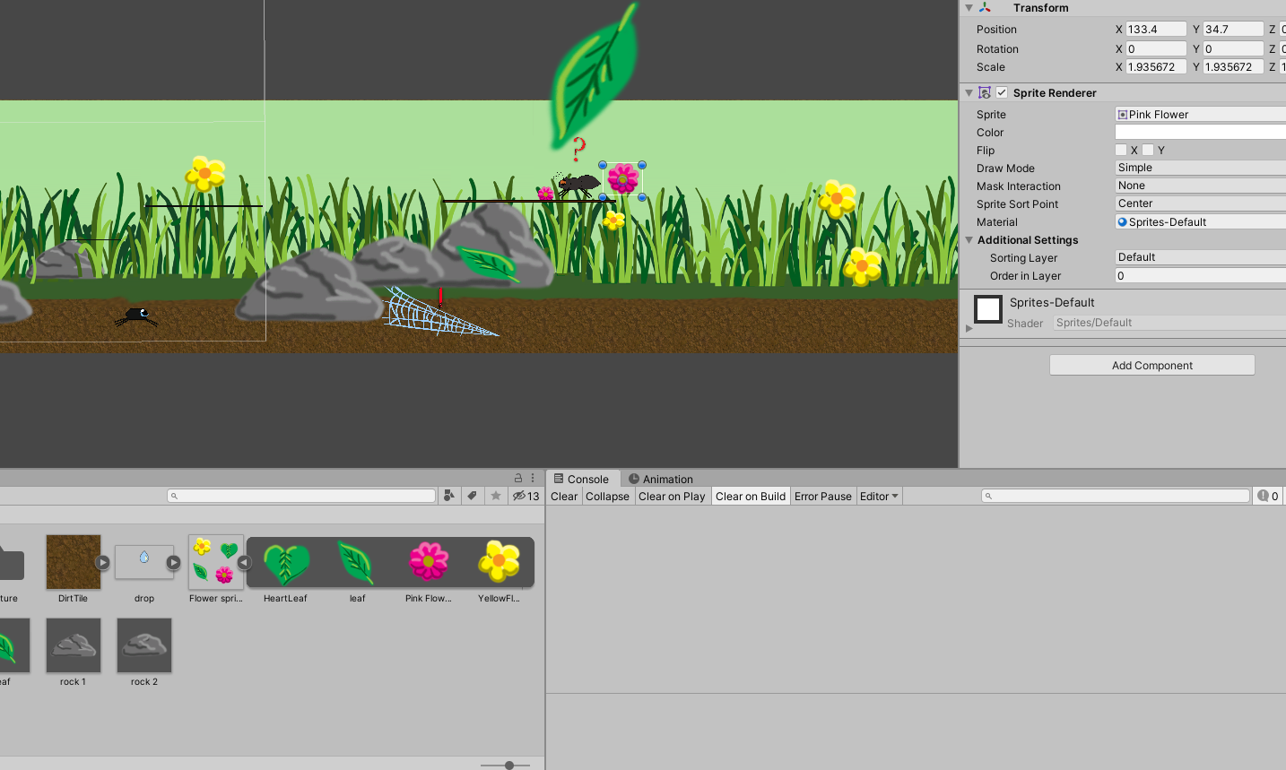
Visual Images
Web Browser is a 2D platforming game it utilizes sprites
Every image in the game was created either by my wife, or myself
No elements that are other’s intellectual property
Sprites are imported into unity where they can be manipulated as in game objects that act as animations or objects

Slide 11
Integrating the parts
Unity requires a combination of game development, graphics design, and programing
Unity was used to glue all the pieces together
C# scripts gave the components functionality and allowed interactions to occur.
Developing the game required lots of small parts to be created then all pieced together in the end
Many parts creates difficulty to manage, with so many dependencies making on change can result in other components breaking.

Slide 12
Challenges
Learning Unity
Creating several mechanics
Debugging and play testing

Slide 13
Learning Unity
Most of the challenge throughout this project was the learning curve for Unity.
While Unity is not particularly difficult, it is a different line of thinking from most IDEs
Much of my learning came from Youtube videos, google searches, and Unity Online Documentation
Interacting between objects required a lot of research and trial and error

Slide 14
Unity Libraries
Some of the biggest challenges were figuring out how to utilize the Unity libraries
All objects in the unity editor have their own class equivalent on the scripting side
Library is unlike many standard console or gui based
Understanding the Update loop and other common functions was challenging

Slide 15
Mechanics
Most challenging mechanic was the questions system
The heart of the game, it needed to be robust
Some difficulty with jumping and movement as well
Save system, initially difficult to work at first
Issues came from transferring information between levels

Slide 16
Player Testing
Player testing was more challenging than expected due to current social distancing
Relied heavily on telecommunication
Sampling adults as well as children
Fewer players than wanted
Many bugs and glitches kept causing the levels to be unable to be completed during testing
Many versions had to be rapidly pushed to allow players to continue playing
While keeping up with debugging the game for the players was challenging, the testing was invaluable

Slide 17

The end
Thank you for watching!

